Slide 5
In physics, a bound state is a composite of two or more building blocks (particles or bodies) that behaves as a single object. In quantum mechanics (where the number of particles is conserved), a bound state is a state in the Hilbert space that corresponds to two or more particles whose interaction energy is negative, and therefore these particles cannot be separated unless energy is spent.
An exciton is a bound state of an electron and hole which are attracted to each other by the electrostatic Coulomb force. It is an electrically neutral quasiparticle that exists in insulators, semiconductors and some liquids. The exciton is regarded as an elementary excitation of condensed matter that can transport energy without transporting net electric charge
A Hilbert space is an abstract vector space possessing the structure of an inner product that allows length and angle to be measured.

Slide 8
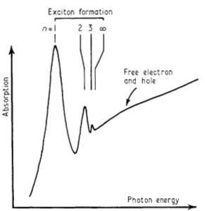
R represents the energy required to ionize an exciton in its lowest energy state, that is, the energy separation between the lowest bound state (n = 1) and the series limit.
E_{n}: energy of the exciton series
E_{ȹ}: series limit (constant)
n: quantum number
R: binding energy (Rydberg constant)

Slide 10
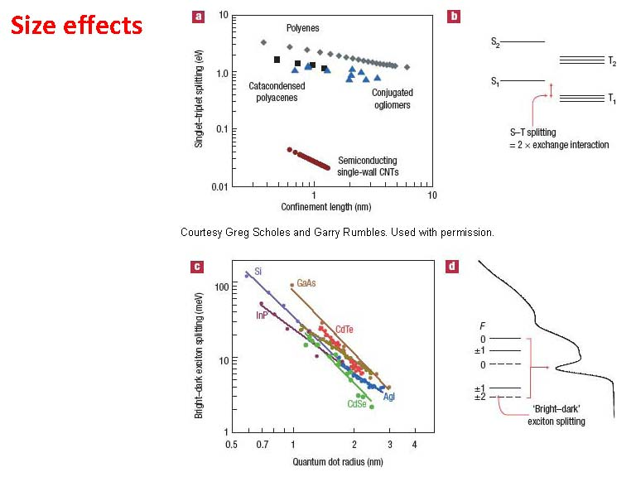

Slide 11
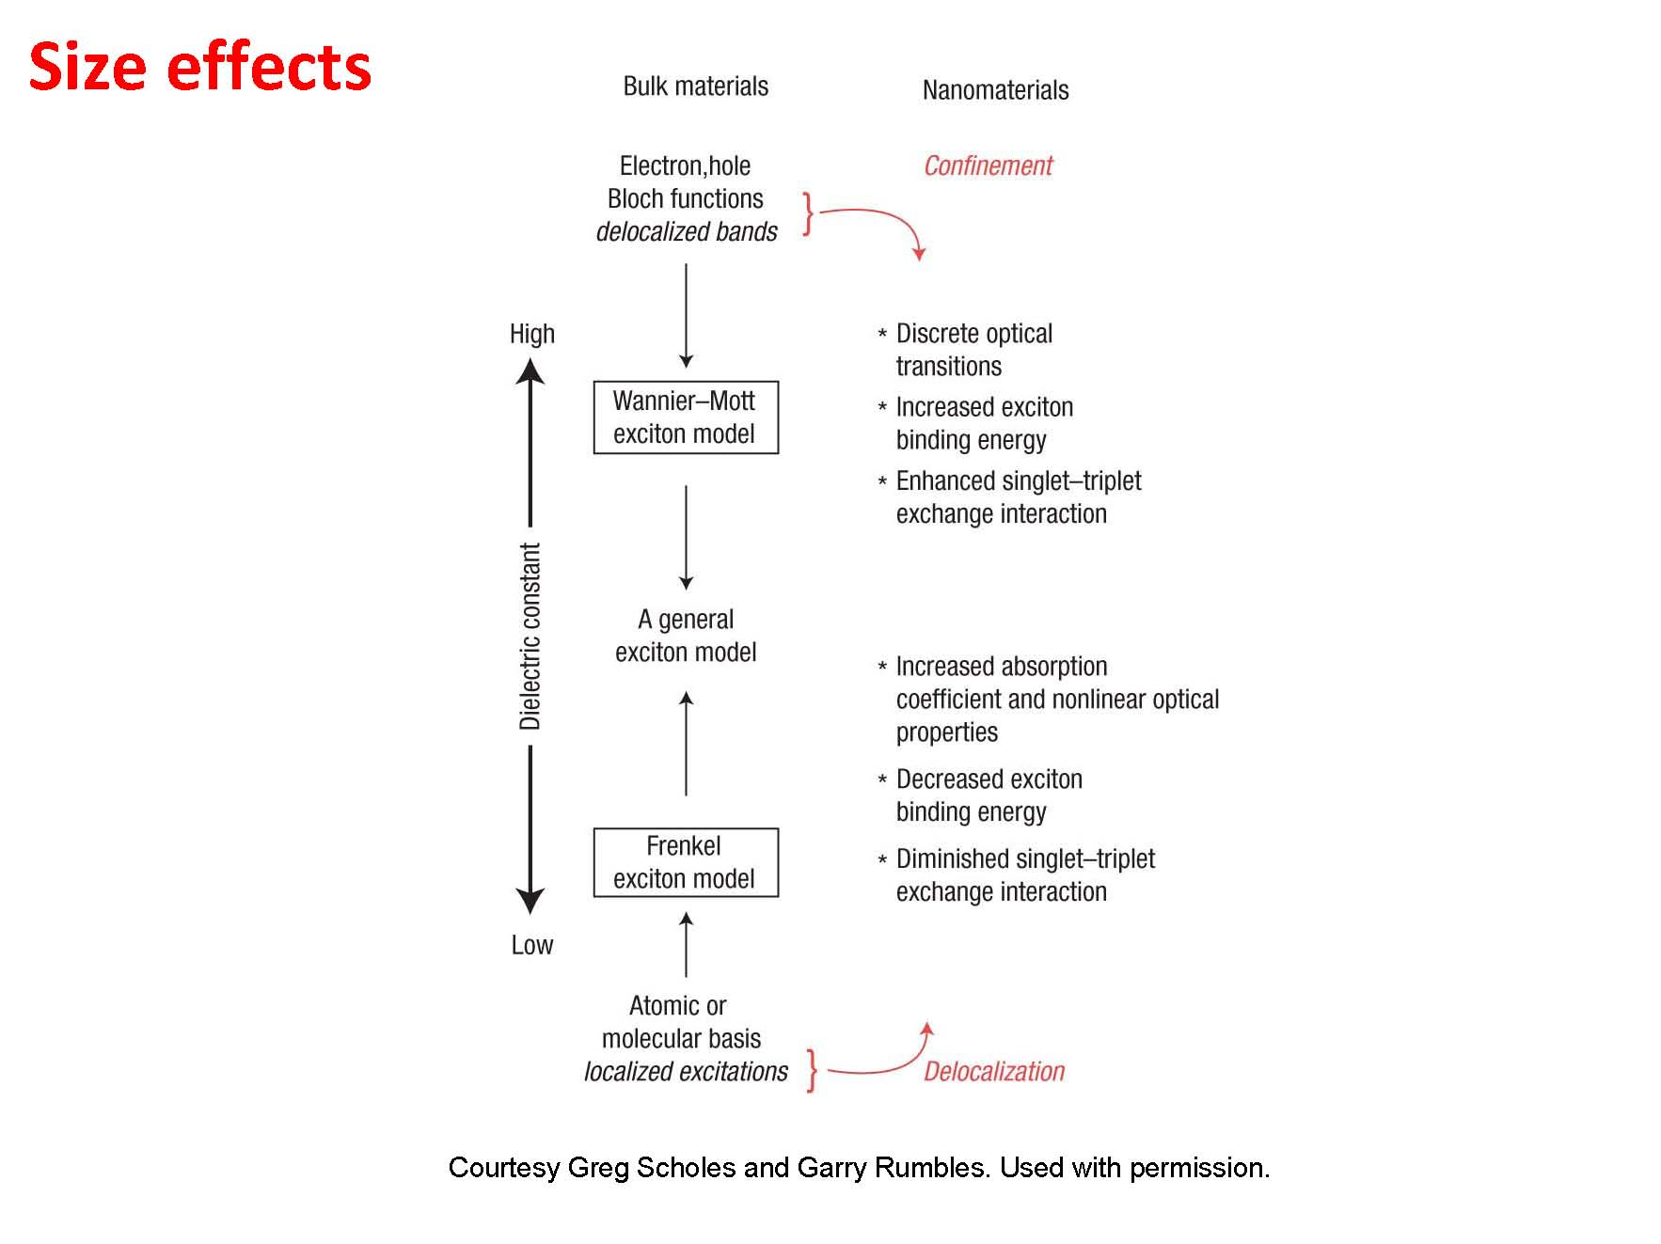

Slide 20
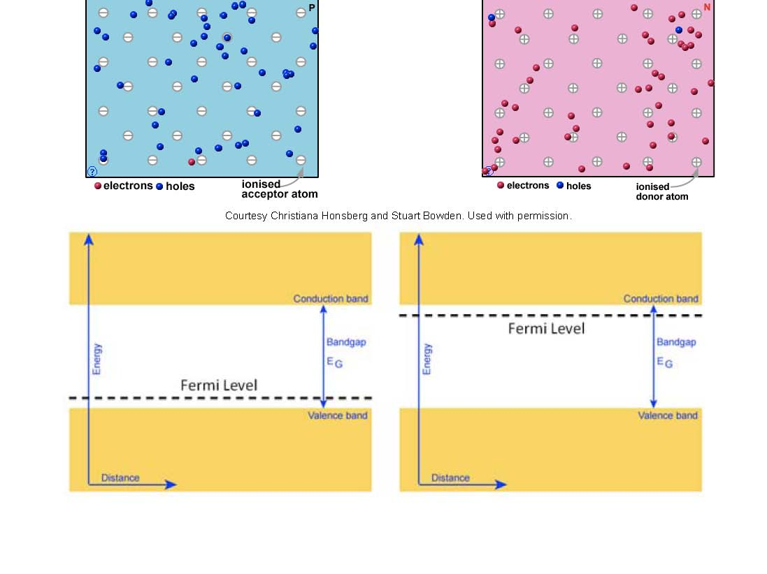

Slide 27
